Slide 1
Combining Experimental Data with Rosetta Computational Models
Jessica A. Finn
jessica.a.finn@vanderbilt.edu

Slide 2
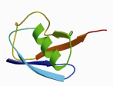
Combine strengths to build accurate models from limited data
Protein structures
consistent with sparse
experimental data
Complete
conformational
space
Native-biased
sampling
strategy
Native-biased
energy
function
Target
structure

Slide 3
Experimental data takes many forms
Distance measurements from chemical crosslinking
Chemical shift or residual dipolar coupling (RDC) data from NMR
Small angle X-ray scattering (SAXS) data
Low-resolution electron density map from electron microscopy (EM) or X-ray crystallography

Slide 4
Rosetta Constraints alter the energy function
Unconstrained
Constrained
E
E
Energetic Evaluation
Energetic Evaluation
Conformational Space
Conformational Space

Slide 5
Rosetta Constraints are provided as a human-readable text file
AtomPair NE2 13 V3 32 HARMONIC 0.0 0.2
Angle CD2 13 NE2 13 ZN 32 HARMONIC 2.09 0.35
Dihedral CG 13 CD2 13 NE2 13 ZN 32 CIRCULARHARMONIC 3.14 0.35
What is Measured
How it is Scored
https://www.rosettacommons.org/docs/latest/rosetta_basics/file_types/constraint-file

Slide 6
Many constraint types exist
AtomPair NE2 13 V3 32 HARMONIC 0.0 0.2
Angle CD2 13 NE2 13 ZN 32 HARMONIC 2.09 0.35
Dihedral CG 13 CD2 13 NE2 13 ZN 32 CIRCULARHARMONIC 3.14 0.35
Distance (AtomPair)
Angle
Dihedral
Coordinate
MultiConstraint
AmbiguousConstraint
KofNConstraint
Harmonic
CircularHarmonic
Flat-bottomed Harmonic
Gaussian
Sigmoid
Bounded
https://www.rosettacommons.org/docs/latest/rosetta_basics/file_types/constraint-file

Slide 7
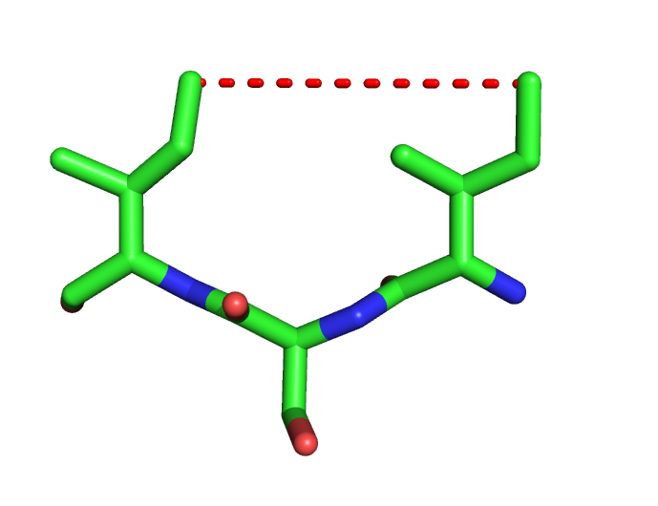
Measurement types
AtomPair CD1 52 CD1 54 HARMONIC 6.0 0.2
Distance (AtomPair)
Angle
Dihedral
Coordinate
MultiConstraint
AmbiguousConstraint
KofNConstraint
https://www.rosettacommons.org/docs/latest/rosetta_basics/file_types/constraint-file

Slide 8
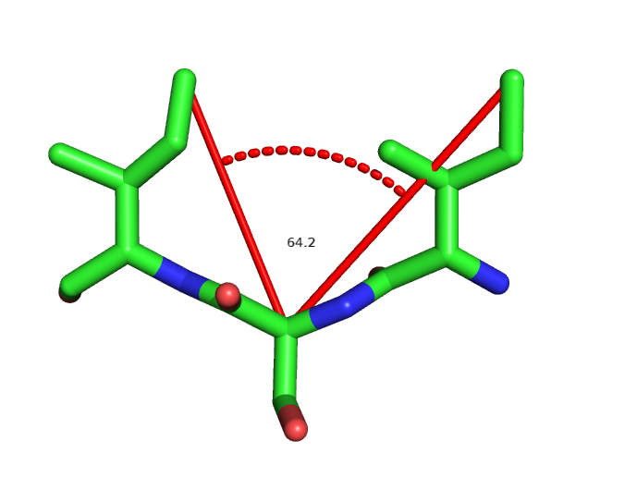
Measurement types
Angle CD1 52 CA 53 CD1 54 HARMONIC 60.0 0.2
Distance (AtomPair)
Angle
Dihedral
Coordinate
MultiConstraint
AmbiguousConstraint
KofNConstraint
https://www.rosettacommons.org/docs/latest/rosetta_basics/file_types/constraint-file

Slide 9
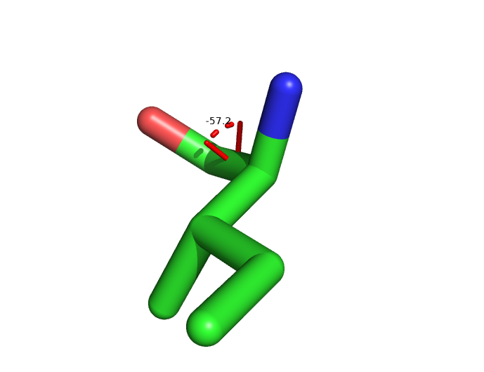
Measurement types
Dihedral N 52 CA 52 C 52 O 52 HARMONIC 0.0 0.2
Distance (AtomPair)
Angle
Dihedral
Coordinate
MultiConstraint
AmbiguousConstraint
KofNConstraint
https://www.rosettacommons.org/docs/latest/rosetta_basics/file_types/constraint-file

Slide 10
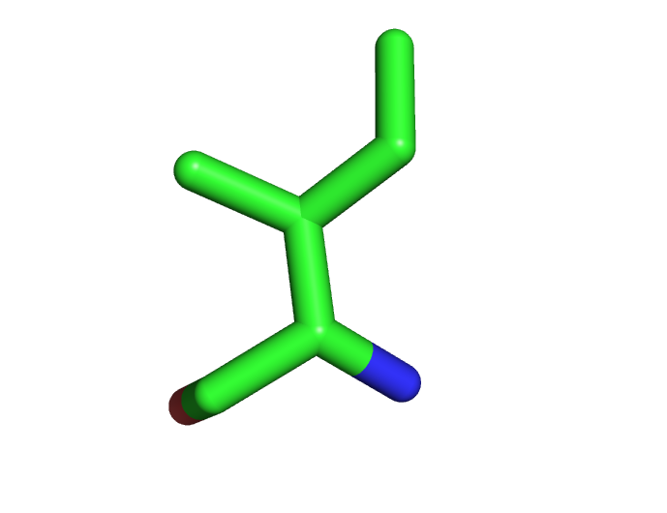
Measurement types
CoordinateConstraint CA 1 CD1 54 X Y Z HARMONIC 0.0 0.2
Distance (AtomPair)
Angle
Dihedral
Coordinate
MultiConstraint
AmbiguousConstraint
KofNConstraint
https://www.rosettacommons.org/docs/latest/rosetta_basics/file_types/constraint-file

Slide 11
Measurement grouping
MultiConstraint
AmbiguousConstraint
KofNConstraint
KofNConstraint 2
AtomPair CD1 52 CD1 54 HARMONIC 6.0 0.2
Angle CD1 52 CA 53 CD1 54 HARMONIC 60.0 0.2
Dihedral N 52 CA 52 C 52 O 52 HARMONIC 0.0 0.2
CoordinateConstraint CA 1 CD1 54 HARMONIC 0.0 0.2
END
https://www.rosettacommons.org/docs/latest/rosetta_basics/file_types/constraint-file

Slide 12
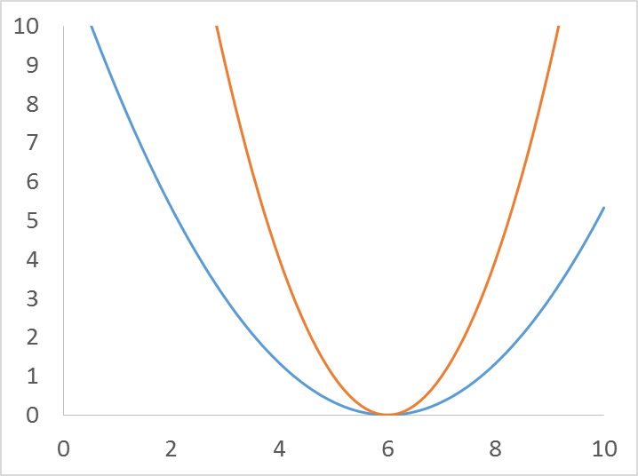
Scoring types
AtomPair CD1 52 CD1 54 HARMONIC 6.0 1.0
HARMONIC 6.0 3.0
Harmonic
CircularHarmonic
Flat-bottomed Harmonic
Gaussian
Sigmoid
Bounded
https://www.rosettacommons.org/docs/latest/rosetta_basics/file_types/constraint-file

Slide 13
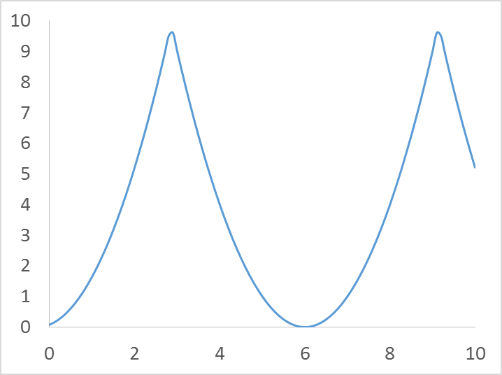
Scoring types
AtomPair CD1 52 CD1 54 CIRCULARHARMONIC 6.0 1.0
Harmonic
CircularHarmonic
Flat-bottomed Harmonic
Gaussian
Sigmoid
Bounded
https://www.rosettacommons.org/docs/latest/rosetta_basics/file_types/constraint-file

Slide 14
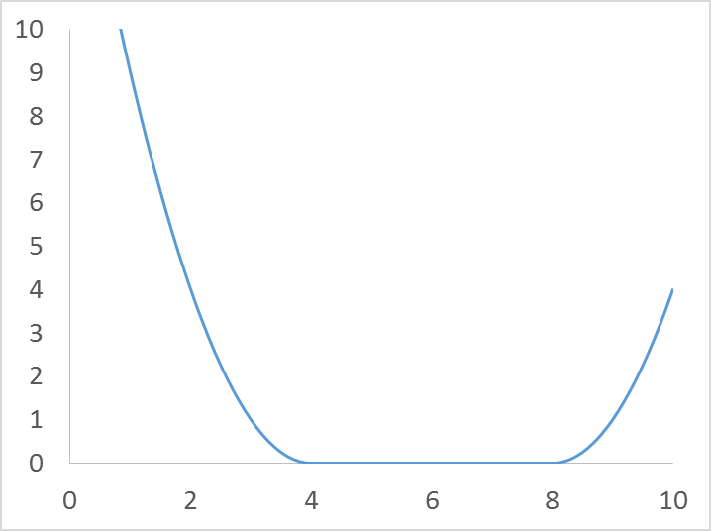
Scoring types
AtomPair CD1 52 CD1 54 FLAT_HARMONIC 6.0 1.0 2.0
Harmonic
CircularHarmonic
Flat-bottomed Harmonic
Gaussian
Sigmoid
Bounded
https://www.rosettacommons.org/docs/latest/rosetta_basics/file_types/constraint-file

Slide 15
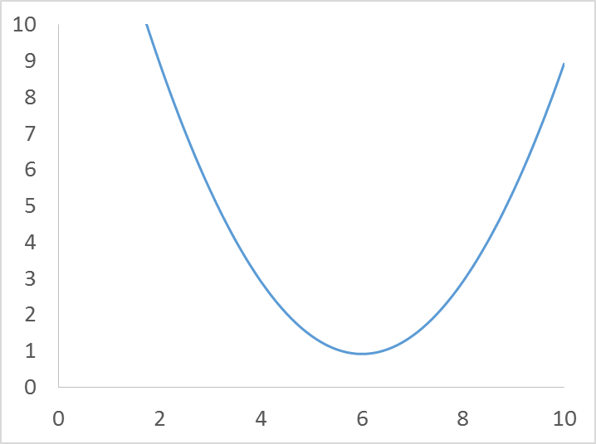
Scoring types
AtomPair CD1 52 CD1 54 GAUSSIANFUNC 6.0 1.0 TAG
Harmonic
CircularHarmonic
Flat-bottomed Harmonic
Gaussian
Sigmoid
Bounded
https://www.rosettacommons.org/docs/latest/rosetta_basics/file_types/constraint-file

Slide 16
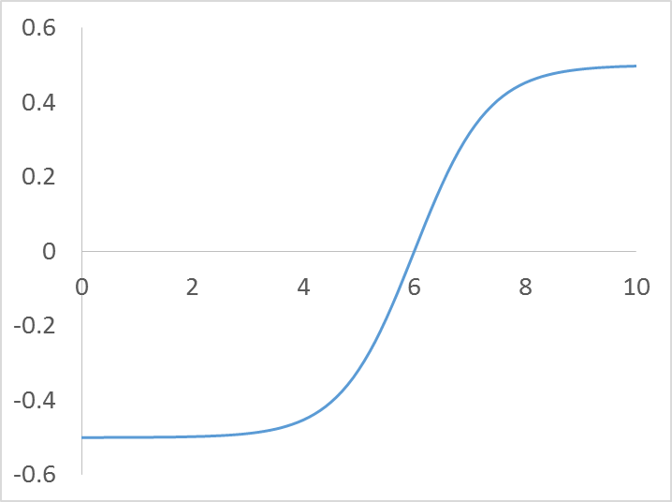
Scoring types
AtomPair CD1 52 CD1 54 SIGMOID 6.0 5
Harmonic
CircularHarmonic
Flat-bottomed Harmonic
Gaussian
Sigmoid
Bounded
https://www.rosettacommons.org/docs/latest/rosetta_basics/file_types/constraint-file

Slide 17
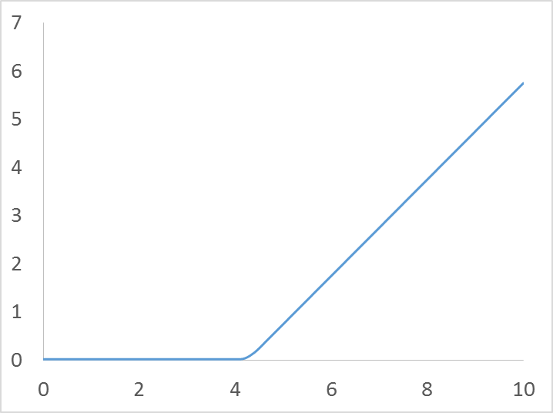
Scoring types
AtomPair CD1 52 CD1 54 BOUNDED 0.0 4.0 1.0 0.5 TAG
Harmonic
CircularHarmonic
Flat-bottomed Harmonic
Gaussian
Sigmoid
Bounded
https://www.rosettacommons.org/docs/latest/rosetta_basics/file_types/constraint-file

Slide 18
Using constraints
Constraints in the Pose
Constraint file
Constraints in the Scorefunction
Weights file
Constraint flags
-constraints:cst_file these_are_my.constraints
-score:weights ref2015_cst.wts

Slide 19
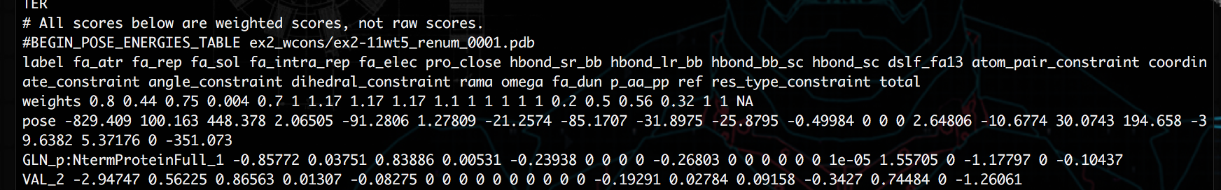
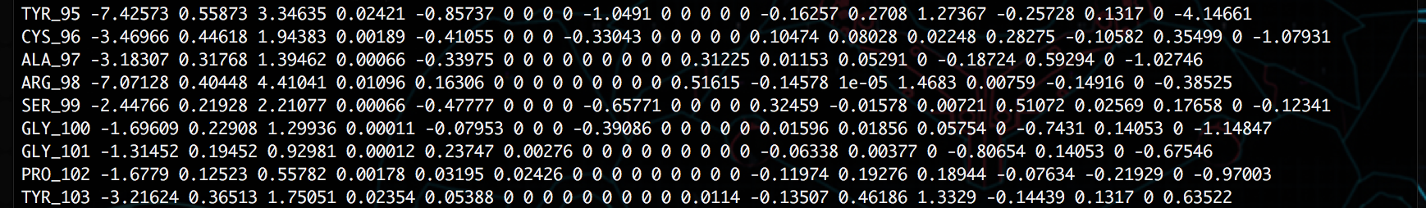
Evaluating constraints
Constraints are added to the score table as additional terms that influence the per-residue and total pose score

Slide 20
Examples of incorporating experimental data as Constraints
Chemical crosslinking distances
DEER EPR distances
NMR NOE distances

Slide 21
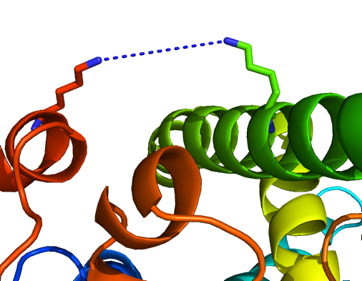
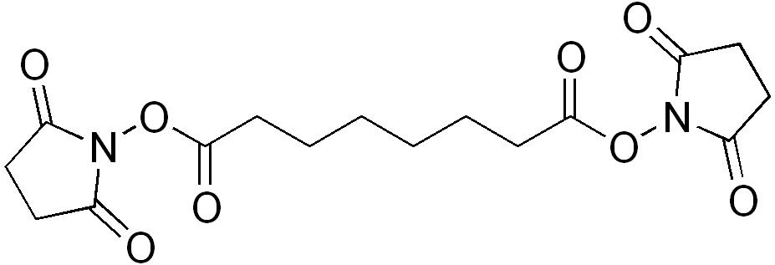
Crosslinks – direct distance measurement
11 Å
Disuccinimidyl suberate (DSS)
Kahraman et al. PLOS One, 2013, 8(9) e73411
rosetta/demos/protocol_capture/xl_driven_protein_docking/

Slide 22
Chemical crosslinking gives distance restraint information
AtomPair CB 67 CB 124 FLATHARMONIC 15.0 1.0 15.0

Slide 23
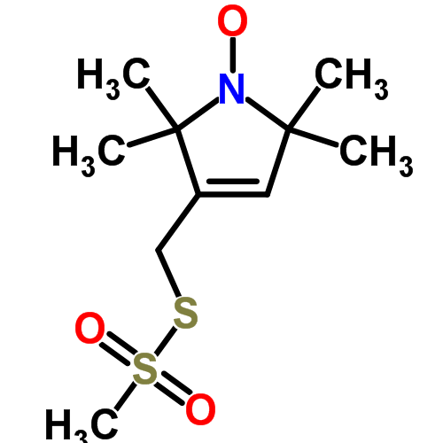
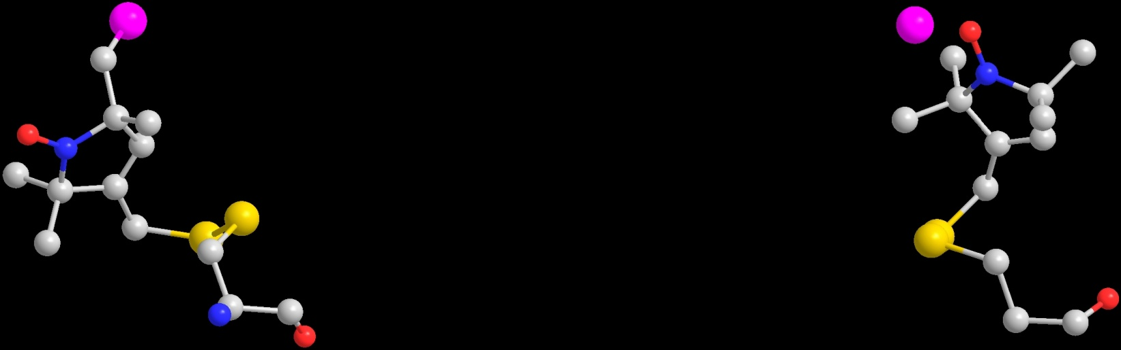
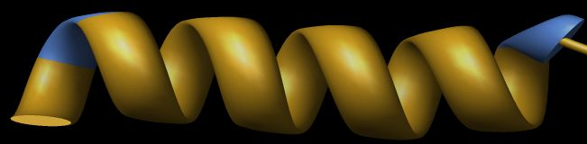
Double Electron-Electron Resonance (DEER) also gives distance information
23 Å
T4L-80
`
MTSL
T4L-65*
C_{α}
C_{α}
Borbat, P. P.; McHaourab, H. S.; Freed, J. H.,
J Am Chem Soc 2002, 124, (19), 5304-14.

Slide 24
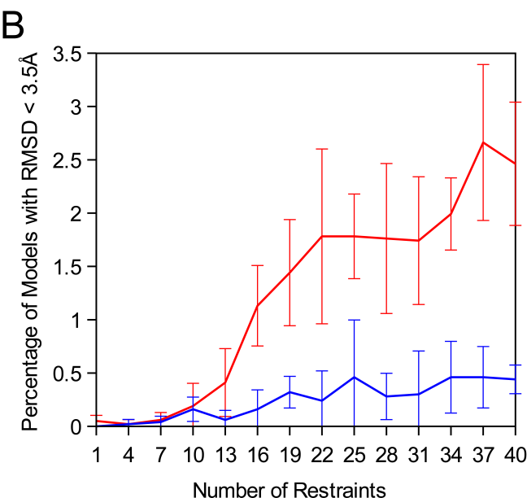
Experimental data influences sampling and model quality
1000
900
800
700
600
Model Count
500
400
300
200
100
0
2
3
4
5
6
7
8
9
10
RMSD in A
plain Rosetta
with EPR restraints

Slide 25
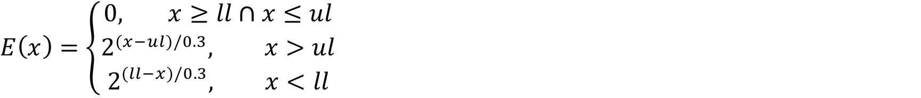
NMR - NOE distance constraints
Simple AtomPair contraints:
AtomPair H 95 H 105 BOUNDED 1.5 3.650 0.3 NOE; amide-amide
Proton Ambiguities:
AmbiguousNMRDistance H 56 QD1 71 BOUNDED 1.5 4.000 0.5 NOE; amide-methyl
Proton/Carbon Ambiguities:
AmbiguousNMRDistance H 55 QQG 94 BOUNDED 1.5 4.000 0.5 NOE; amide-methyl
AmbiguousNMRDistance QQD 25 QQG 108 BOUNDED 1.5 4.000 0.5 NOE; methyl-methyl
All restraints must be mapped into the centroid representation:
cat [fullatom Rosetta constraint file] | perl map_csts_to_centroid_simple.pl > [centroid Rosetta constraint file]

Slide 26
Other examples of incorporating experimental data
Chemical Shift Homology Modeling (CS-HM Rosetta)
Chemical shifts influencing fragment selection
RDC restraints
Electron density restraints

Slide 27
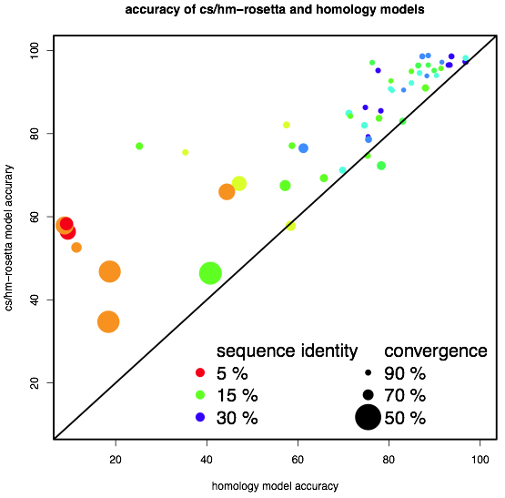
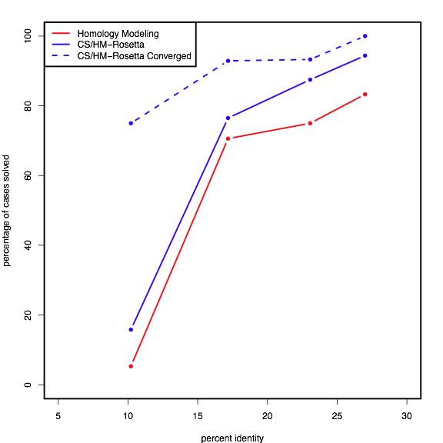
CS-HM Rosetta improves the performance of homology modeling
B
C
Thompson, Sgourakis et al., PNAS, 2012
Notes:
Figure 4: Models made with homology information and chemical shift data improve over comparative models. Independent calculations were performed using chemical shift data and homology modeling restraints derived from templates of varying evolutionary distance. CS-Rosetta ensembles were made by taking the lowest ten energy models from each independent calculation, and convergence was calculated as the average number of residues superimposable with 1.5A between structures in the ensemble.
B: Ensemble convergence correlates with model accuracy. Each point represents the accuracy of models built with only homology information versus the accuracy of the CS-Rosetta ensemble built with the same homology information plus chemical shift data. The CS-Rosetta consistently improve over the homology models, and model accuracy correlates better with convergence (Spearman’s rho = 0.82) than with sequence identity (Spearman’s rho = 0.72).
C: Combining chemical shift data and homology modeling information consistently improves success. Each cases from (A) was placed in a bin based on the evolutionary distance of the homology information used in the simulation. Cases were considered solved if the model agreed within 1.5A of the deposited NMR ensemble for at least 75% of the ordered NMR structure. A protocol using both backbone chemical shifts and homology information (blue line) improves consistently on homology models (red line). Consistent success is seen when only converged cases are considered (dashed blue line).

Slide 28
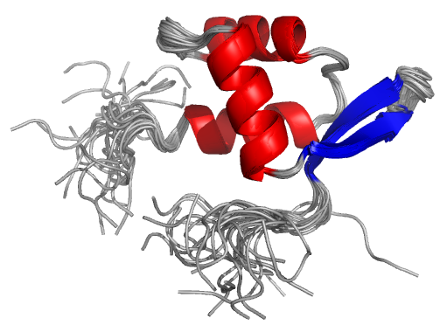
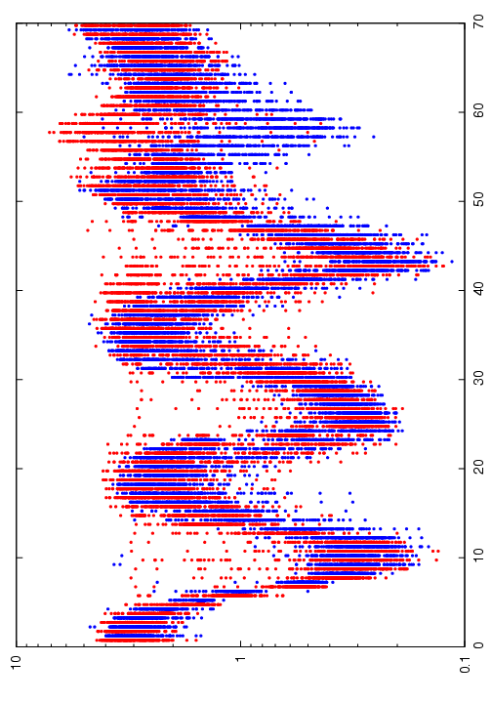
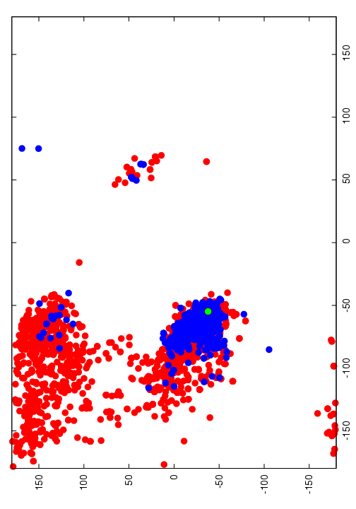
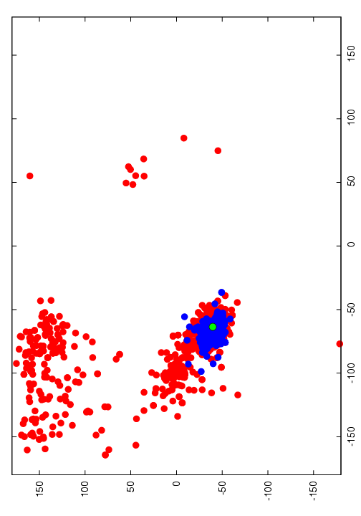
Chemical Shifts help fragment picking
Fragment Comparison
Residue 61
ψ
ϕ
Residue 45
Cα RMSD to Native
ψ
Sequence Position
ϕ
Red: Rosetta Fragments, picked by Sequence profile & Secondary Structure Prediction
Blue: CSRosetta Fragments, picked by CS Comparison & Sequence Matching

Slide 29
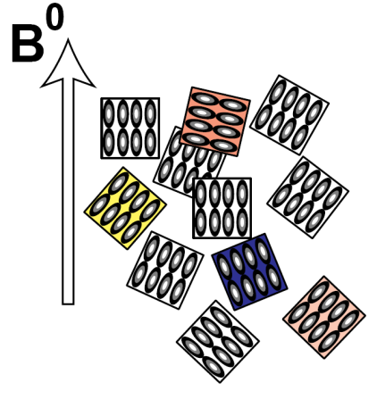
RDC restraints
Multiple bond vector support (data are automatically scaled relative to N-H)
3 N 3 H 6.64; amide
3 C 4 N 3.34; C’-N
3 C 3 CA 3.4; C’-Ca
Support of multiple alignment datasets
-in:file:rdc gel.rdc phage.rdc
2 types of scoring:
1) Singular value decomposition
-rdc:fit_method svd
2) Non-linear fitting of the 5 alignment tensor parameters
-rdc:fit_method nls
-rdc:fixDa [value]
-rdc:fixR [value]
Evaluation of Q-factors, al. tensor parameters calculated RDCs:
-out:level 999 |grep Qbax || Da || Rh ; exactly the same output as PALES
-rdc:print_rdc_values calc.rdc
Lack of molecular tumbling
Rossi, et al. 2015 Proteins 83:309
Notes:
Orientation of nh bond vectors

Slide 30
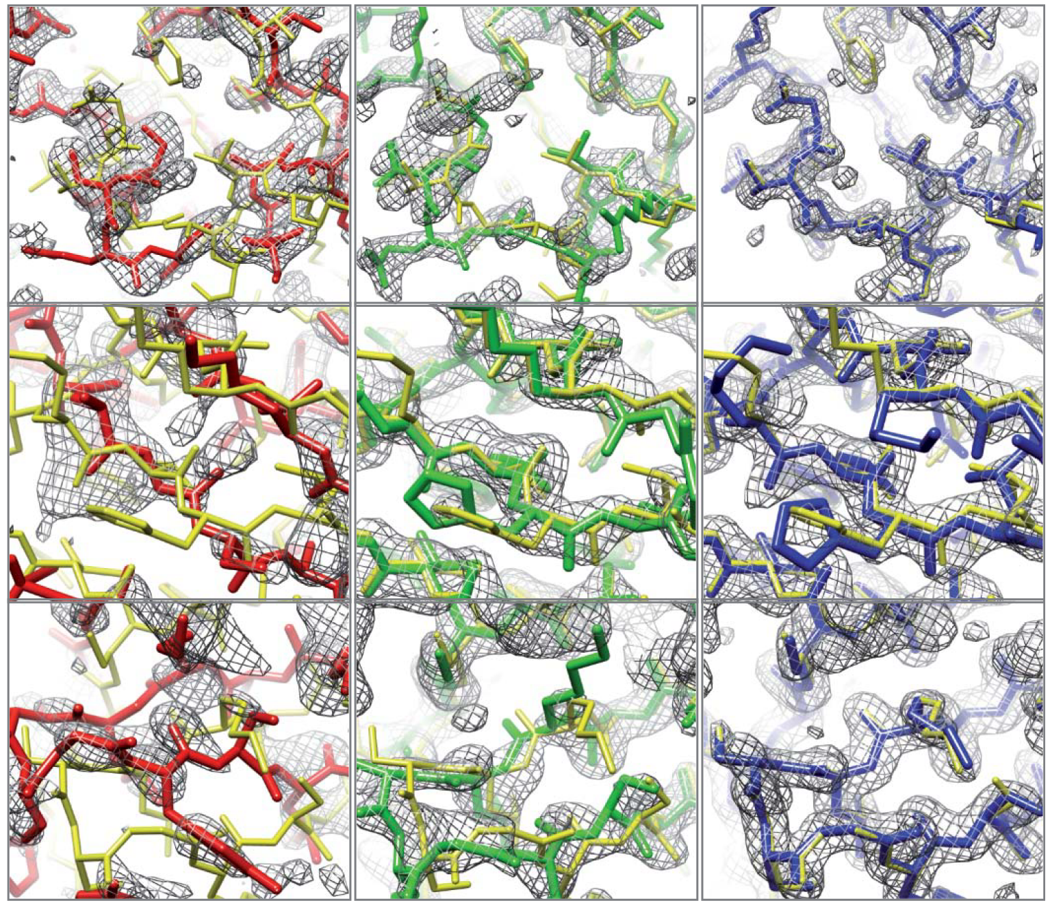
Electron density restraints (EM, X-ray)
DiMaio F. (2011) Nature
Initial molecular replacement
Model rebuilding and energy optimization
Improve Phases

Slide 31
Questions?

